Slide 1
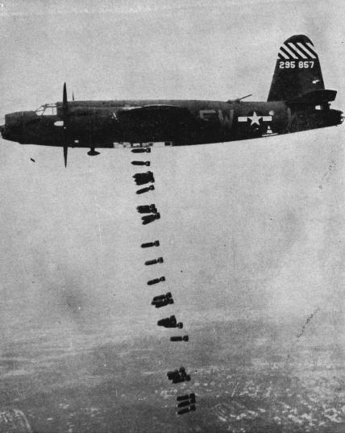
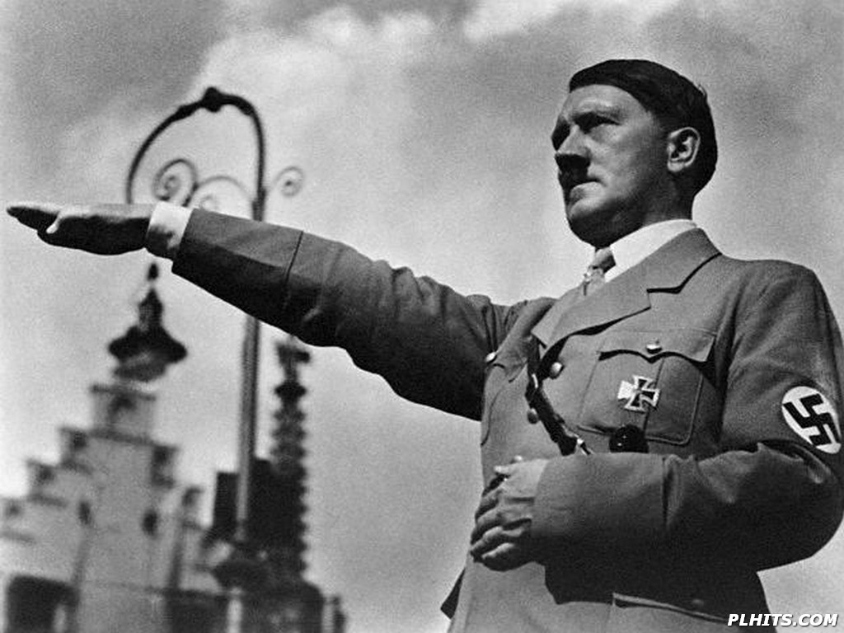
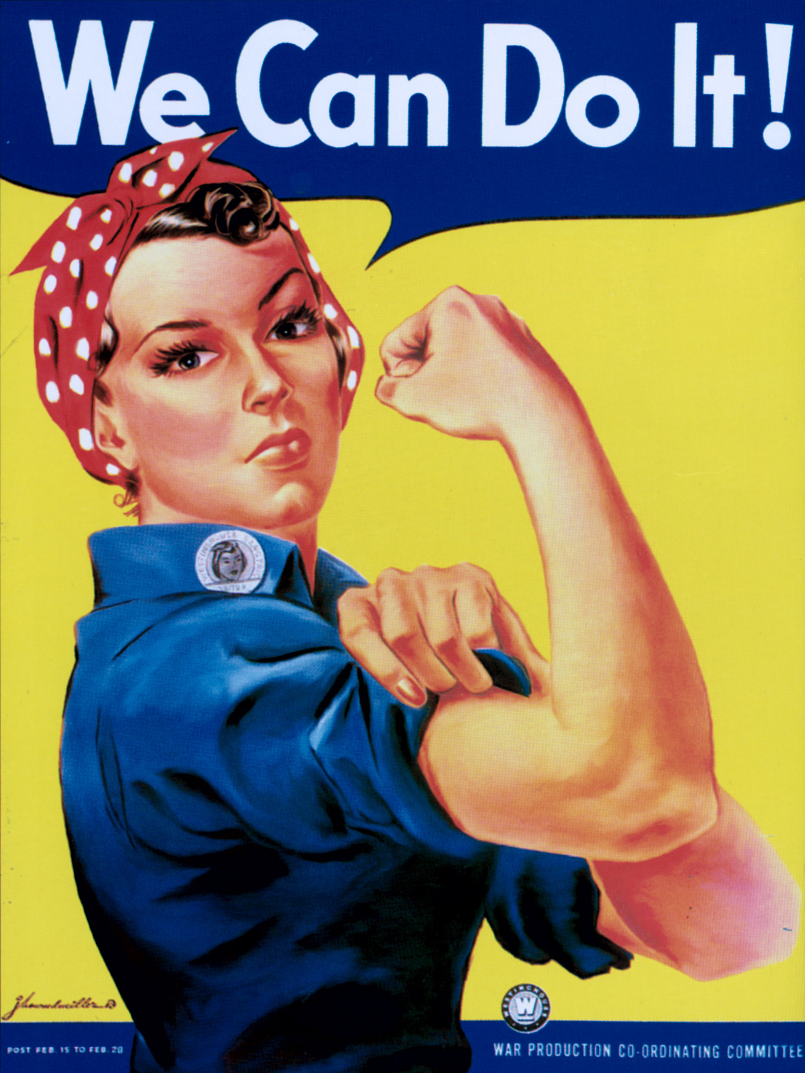
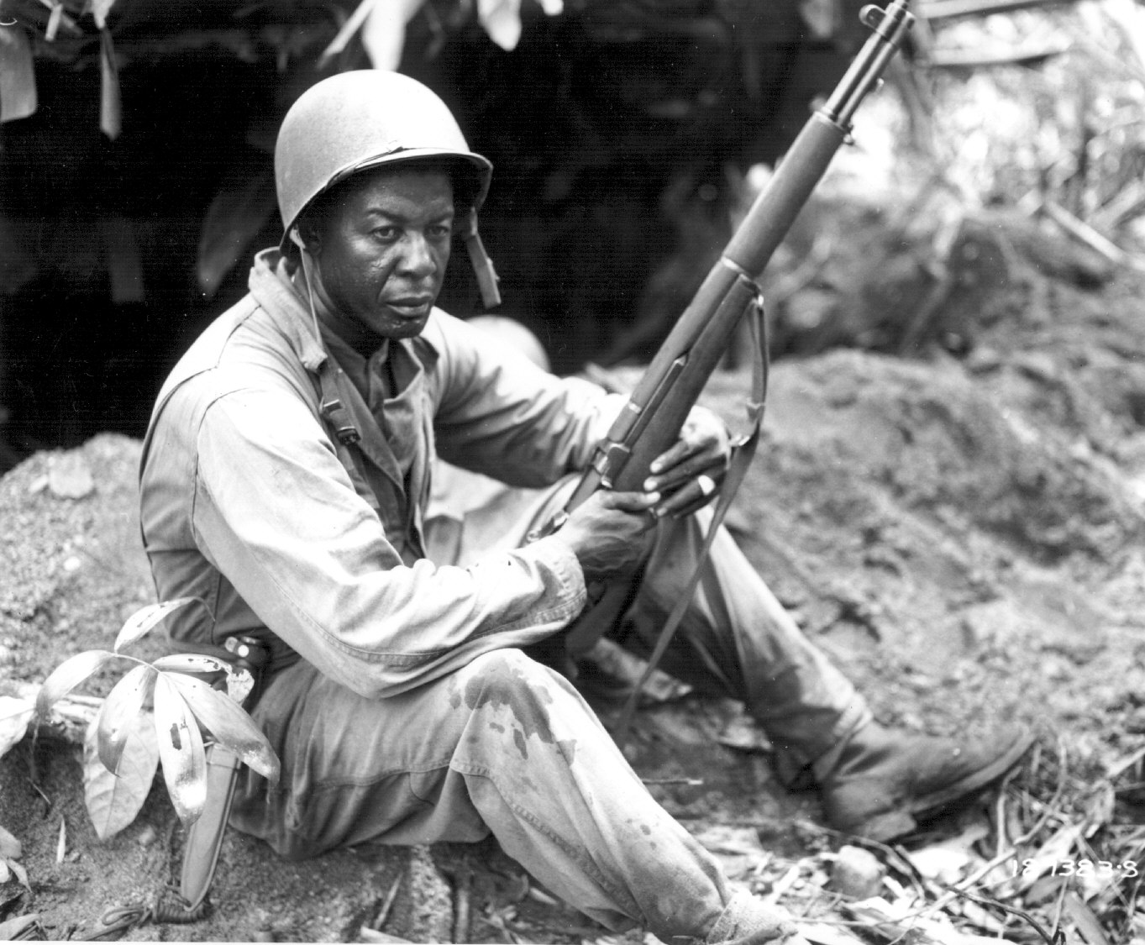
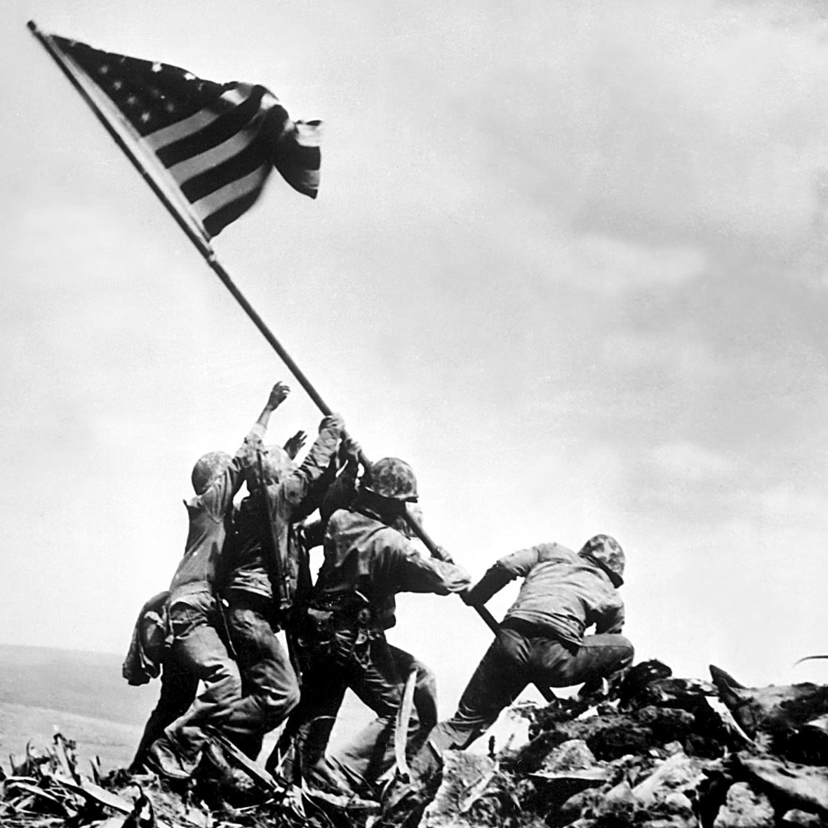
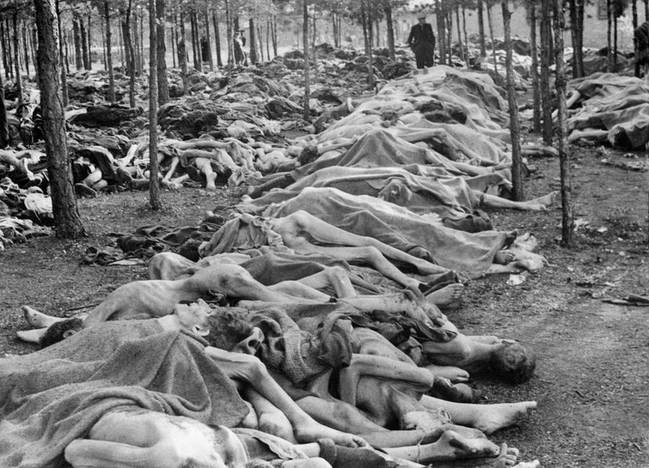
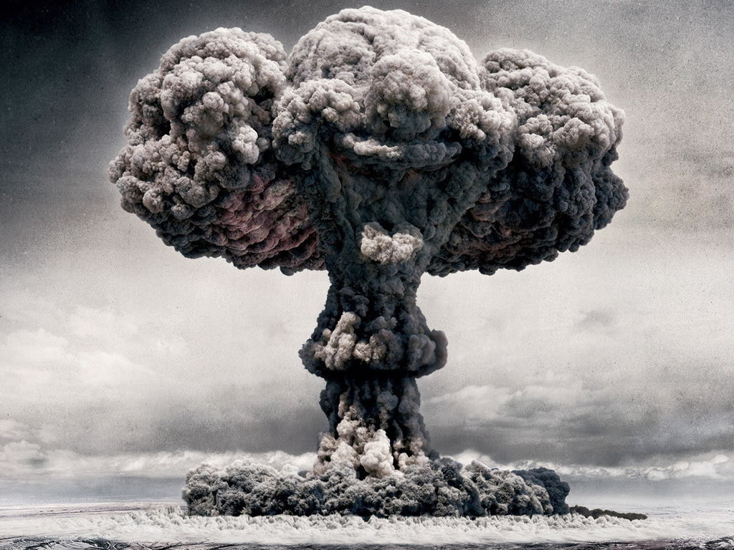
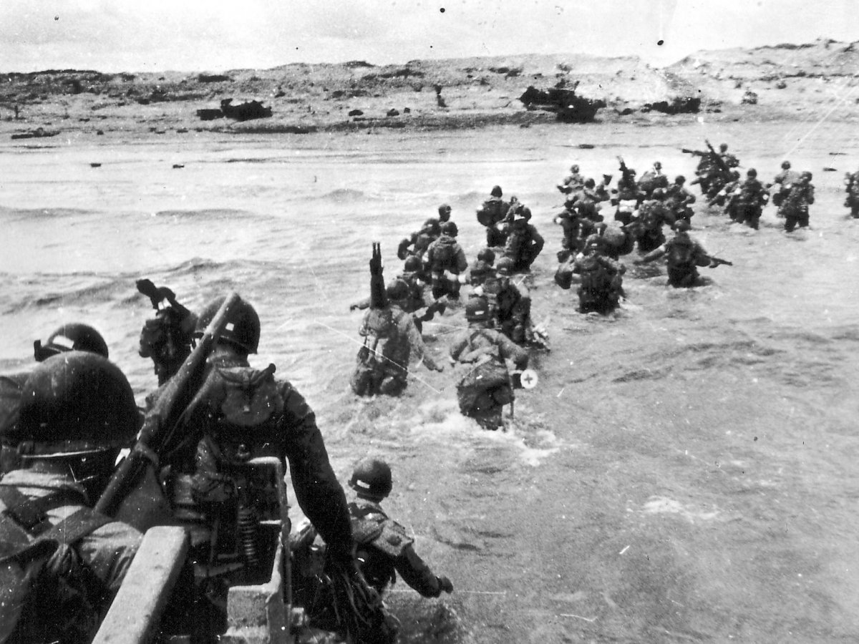
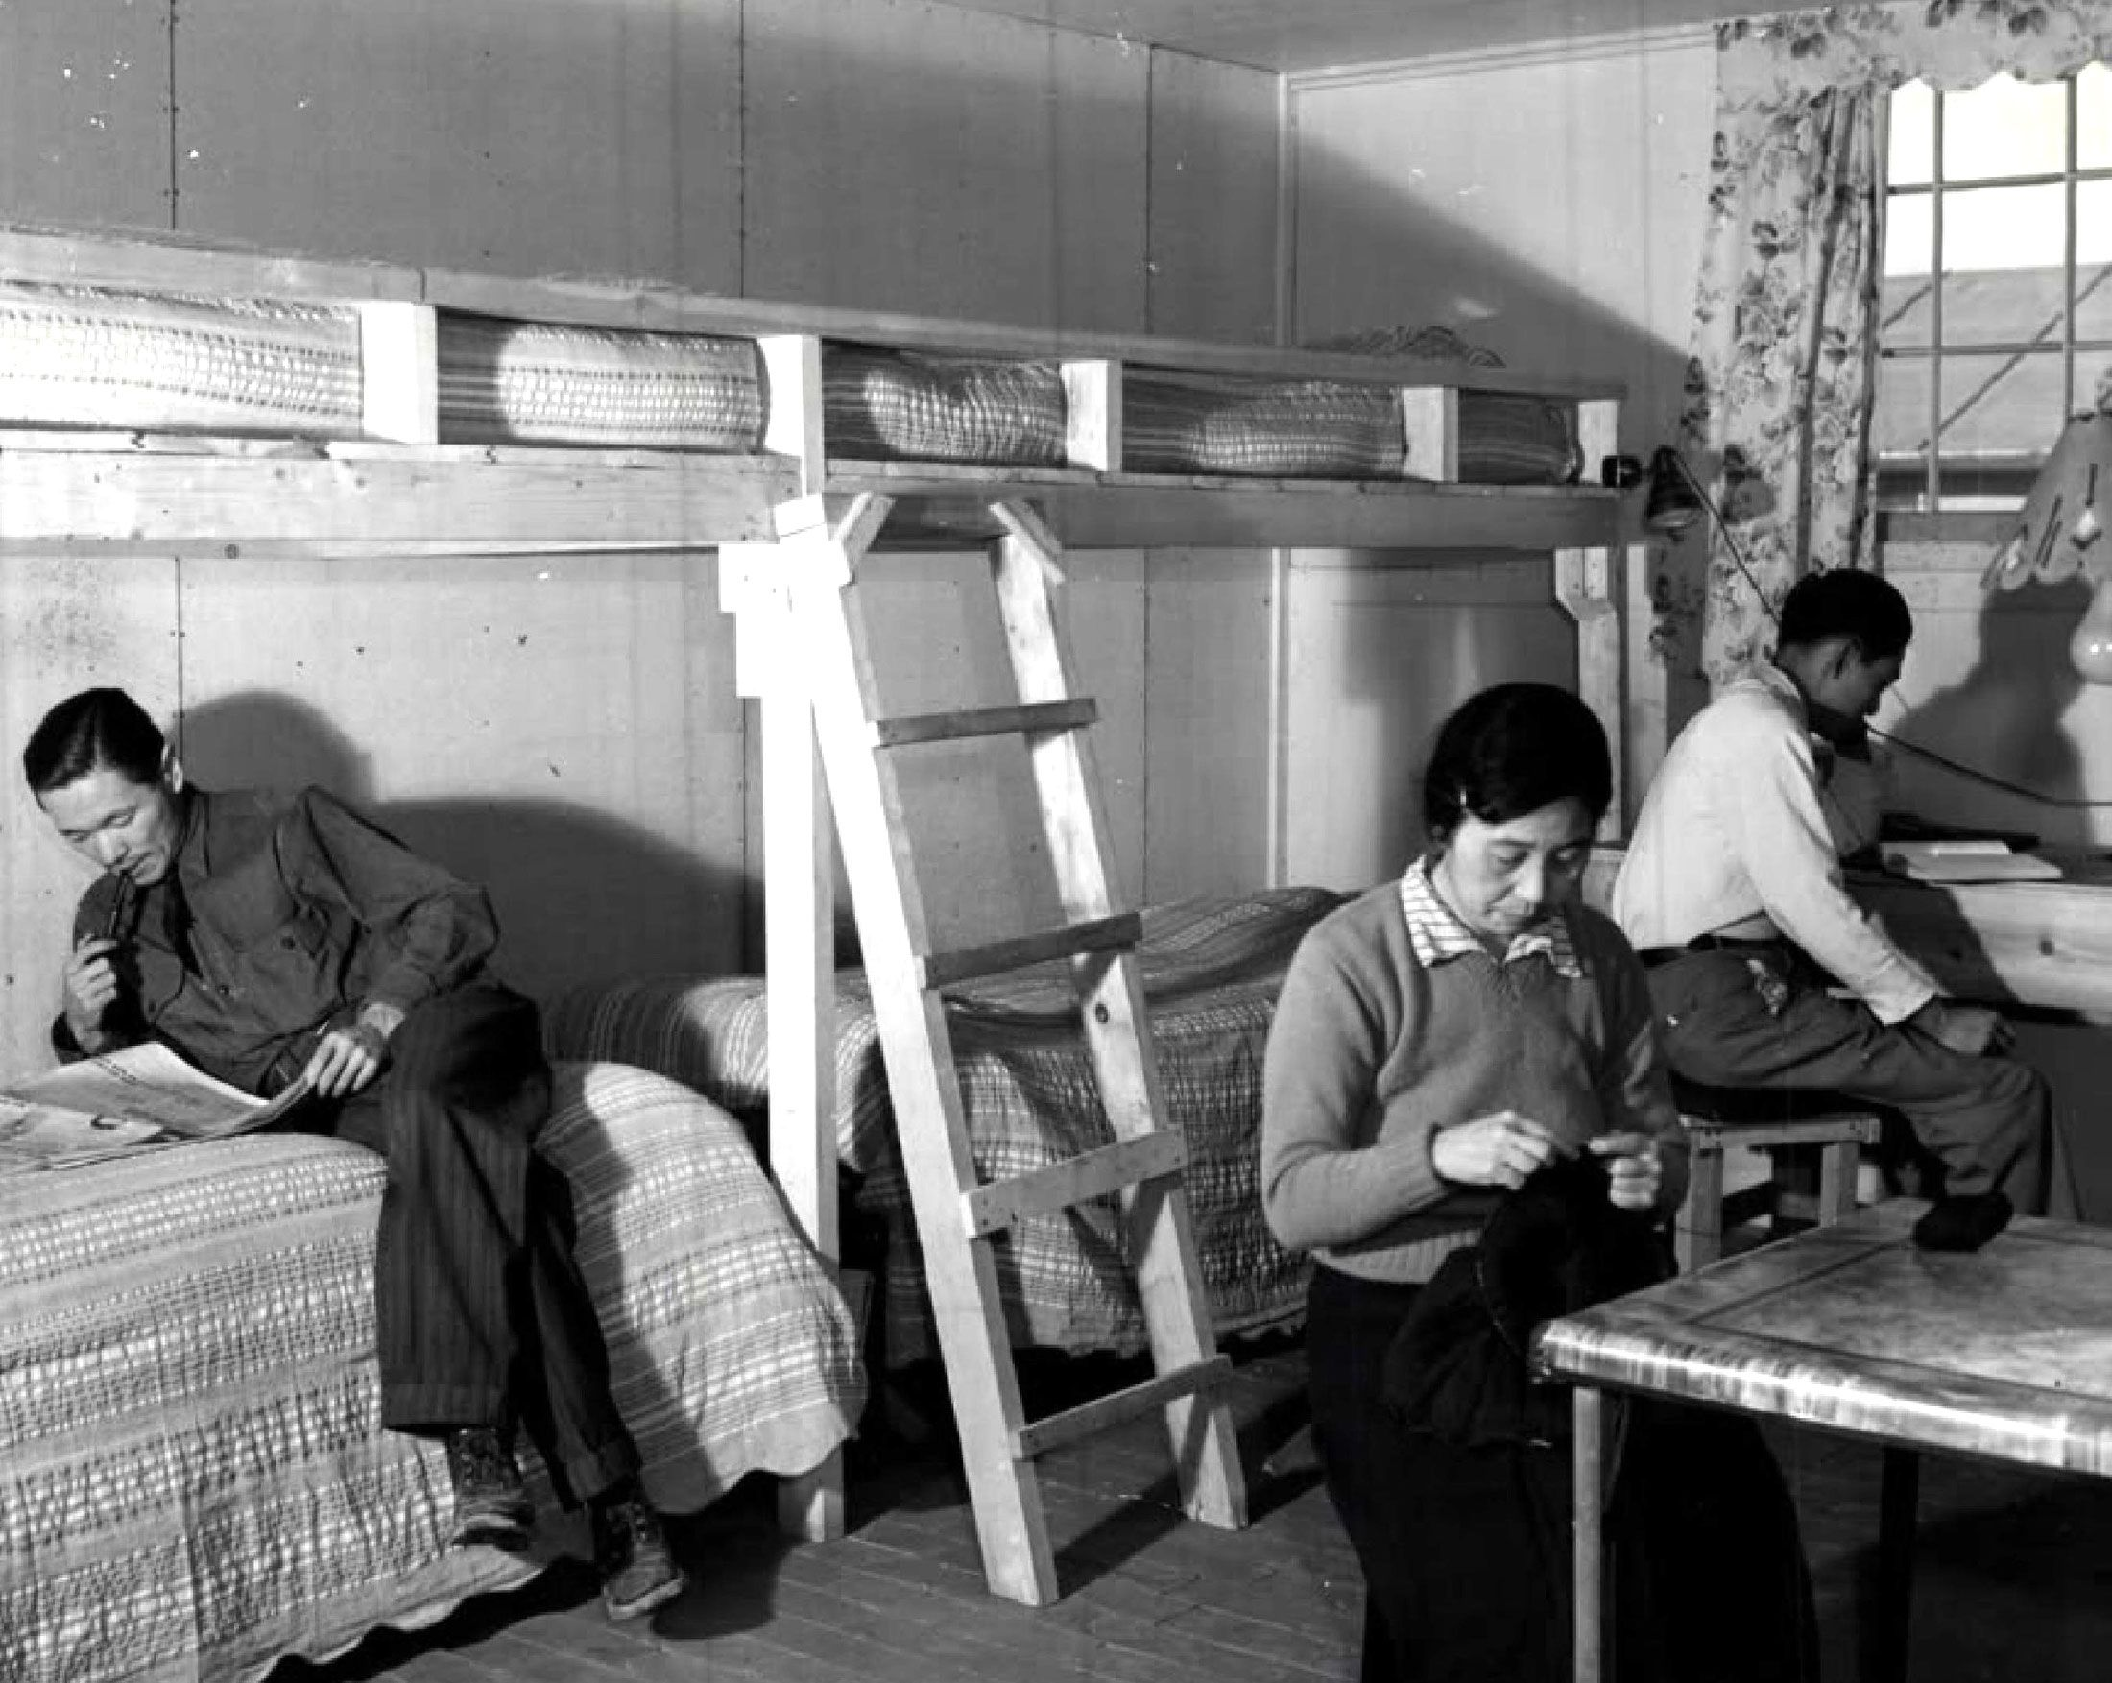
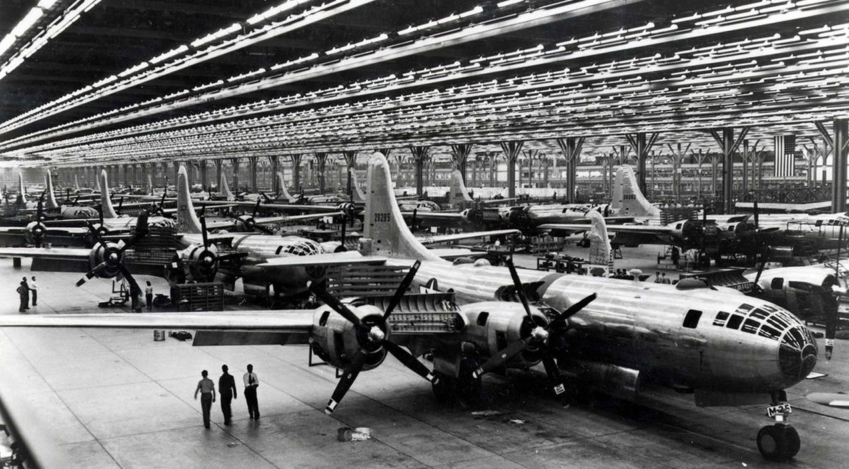
World War Two

Slide 2
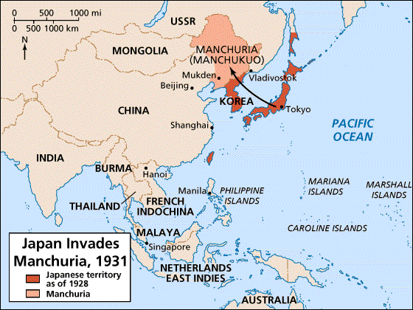
Japan Invades Manchuria 1931

Slide 3
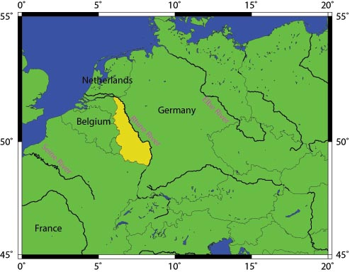
Germany Occupies the Rhineland 1936

Slide 4
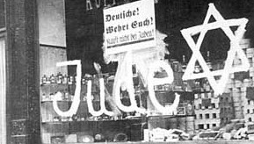
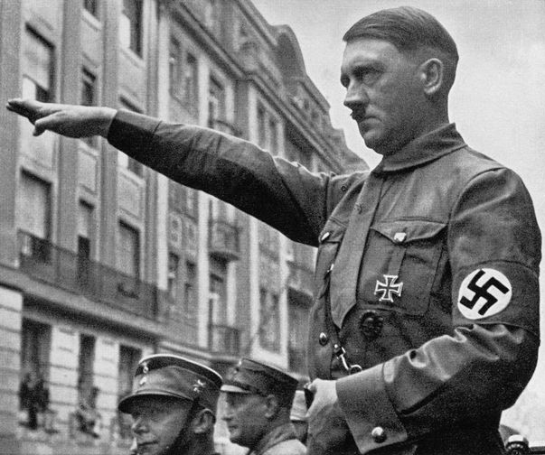
German Anti-Semitism
Hitler’s Mein Kampf advanced “stab-in-the-back” narrative of outcome of WWI, worldwide Jewish Bolshevik conspiracy
Nuremburg Laws limited citizenship to pure-blood Germans, defined Jewishness, and strictly limited rights

Slide 5
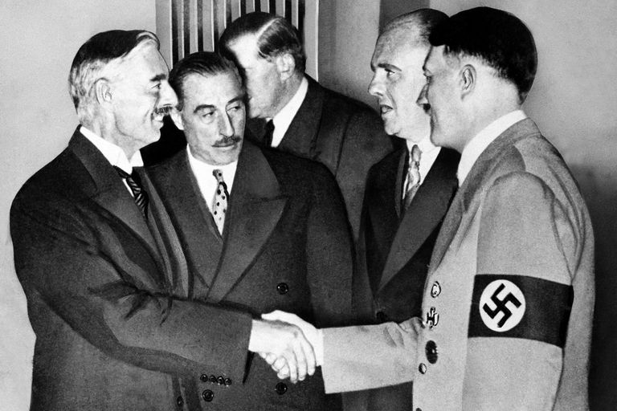
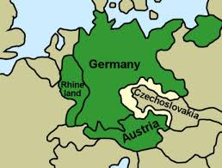
Munich Agreement, 1938
France and Britain agreed to stand down while Germany annexed the “Sudetenland“ German speaking regions of Czechoslovakia
Neville Chamberlain thought it would “appease” Hitler
He proceeded to invade the rest of Czechoslovakia

Slide 6
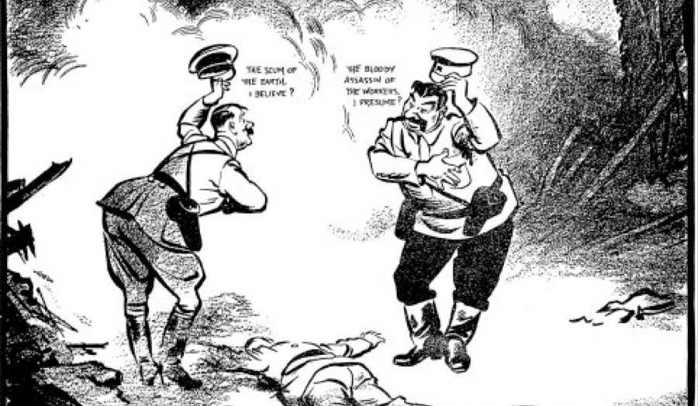
Hitler-Stalin Pact
Russia feeling encroached on both sides first pushes Popular Front against fascism, 1935
In a startling reversal, signs non-aggression pact with Germany in 1939

Slide 7
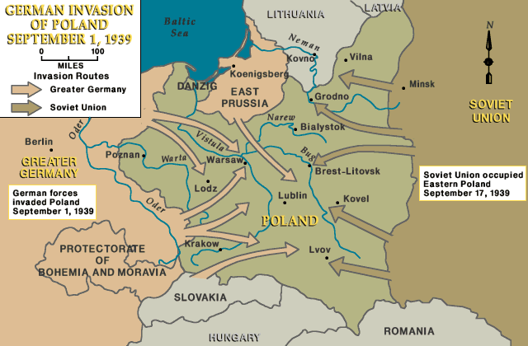
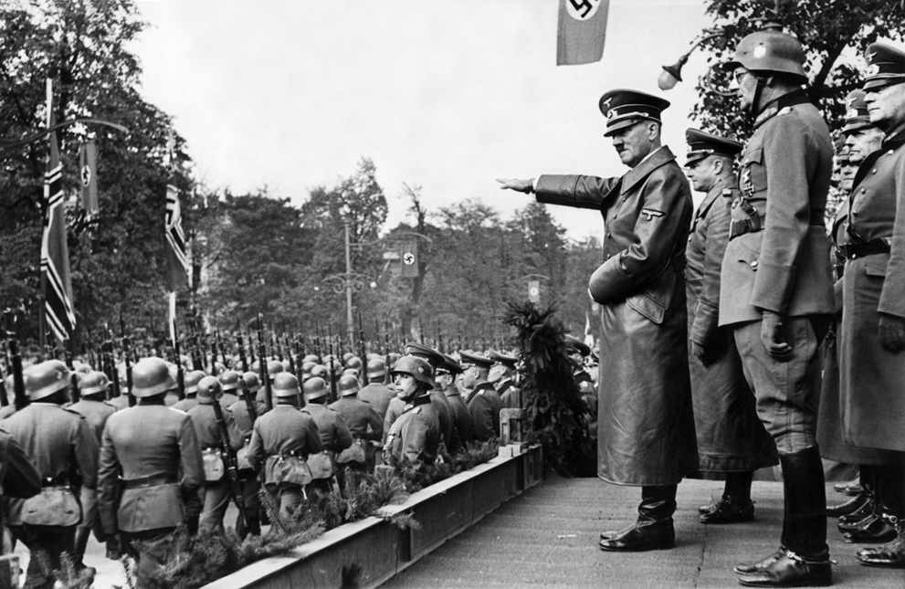
Invasion of Poland

Slide 8
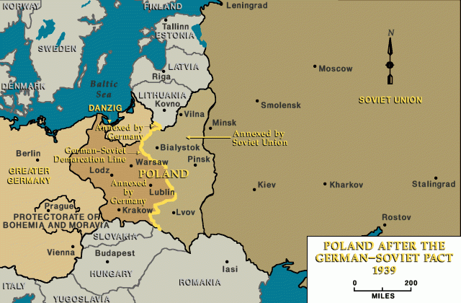
German/Russian Partition of Poland

Slide 9
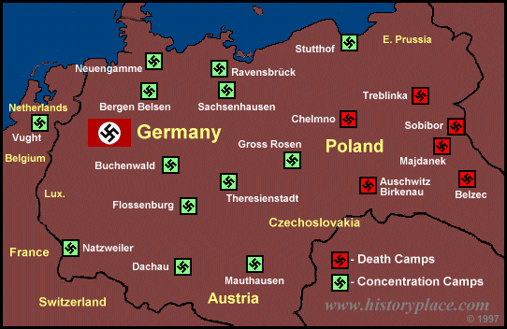
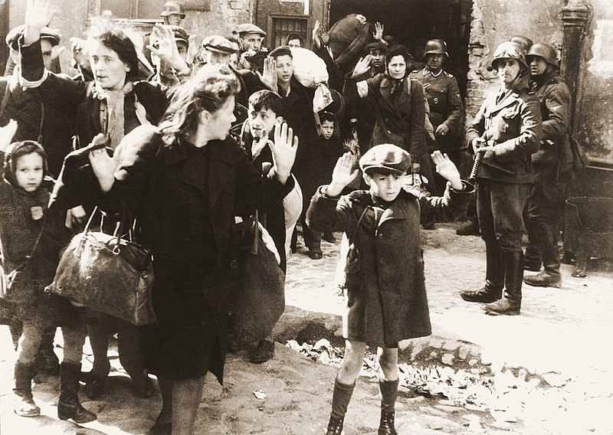
The Holocaust
Jews were herded into ghettos
After Kristallnacht (9-10 November 1938) began sending Jews to concentration camps
After Final Solution (systematic genocide) January 1942, shipped Jews to death camps in German occupied Poland

Slide 10
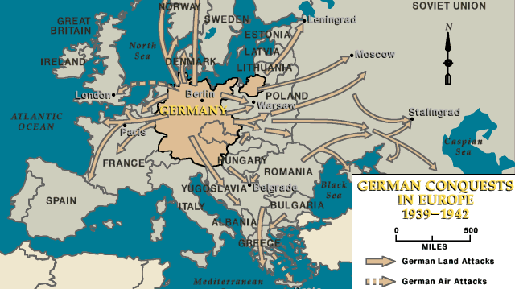

Slide 11
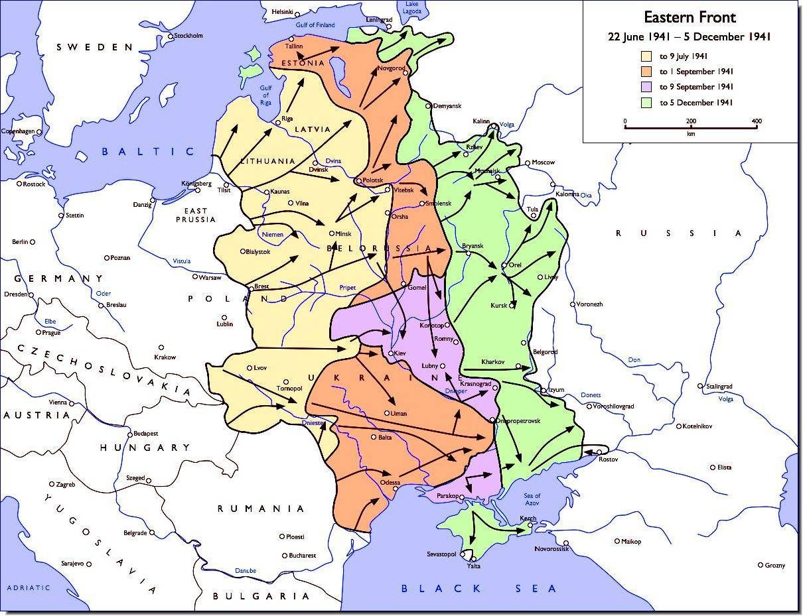

Slide 12
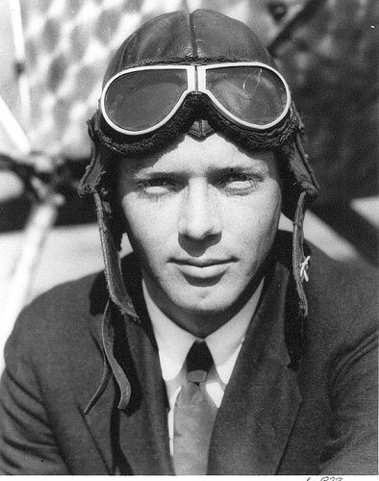
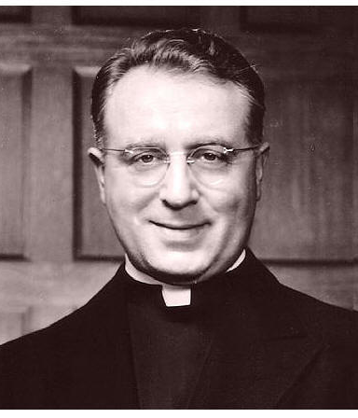
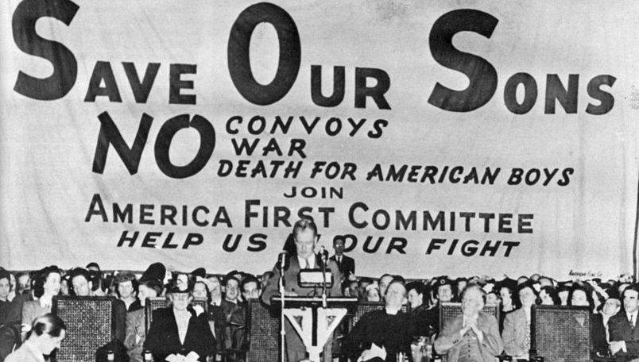
America First Committee
Organized by Fascistic Father Coughlin, Charles Lindbergh
Hundreds of thousands of members, vocal and ardently against getting involved in the war

Slide 13
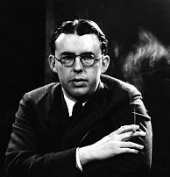
Popular Front Anti-Fascists
Popular Front motivated by Hitler’s growing strength
“Anti-Fascism” created common ground for liberals and Communists, at least prior to Hitler-Stalin pact

Slide 14
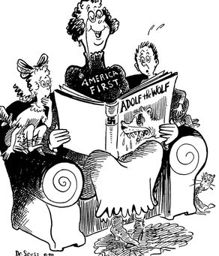
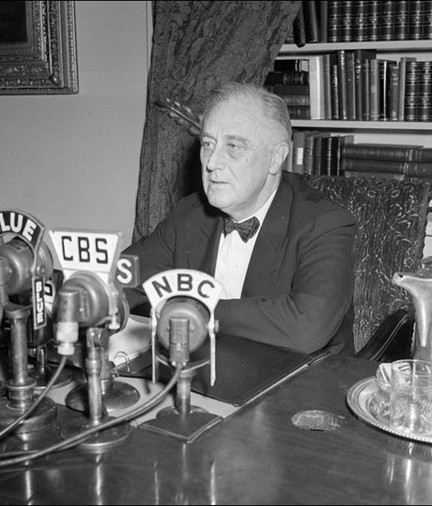
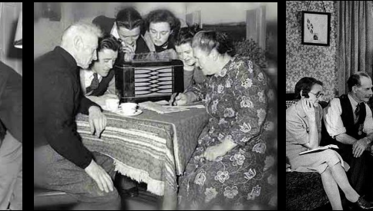
Changing the Message
FDR Secure Following Unprecedented Election to Third Term
Use of Fireside Chats
“Internationalists” formed organizations such as Free World Association, Freedom House to Combat America Firsters
Dr Seuss published political cartoons

Slide 15
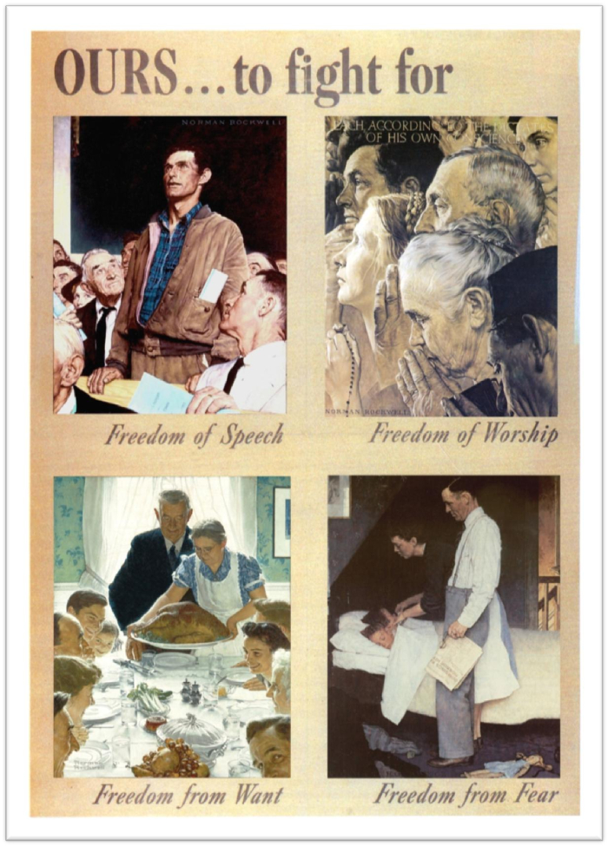
Fighting for Four Freedoms
“Negative” freedoms- freedom of worship, freedom of worship
“Positive” freedoms- freedom from want, freedom from fear

Slide 16
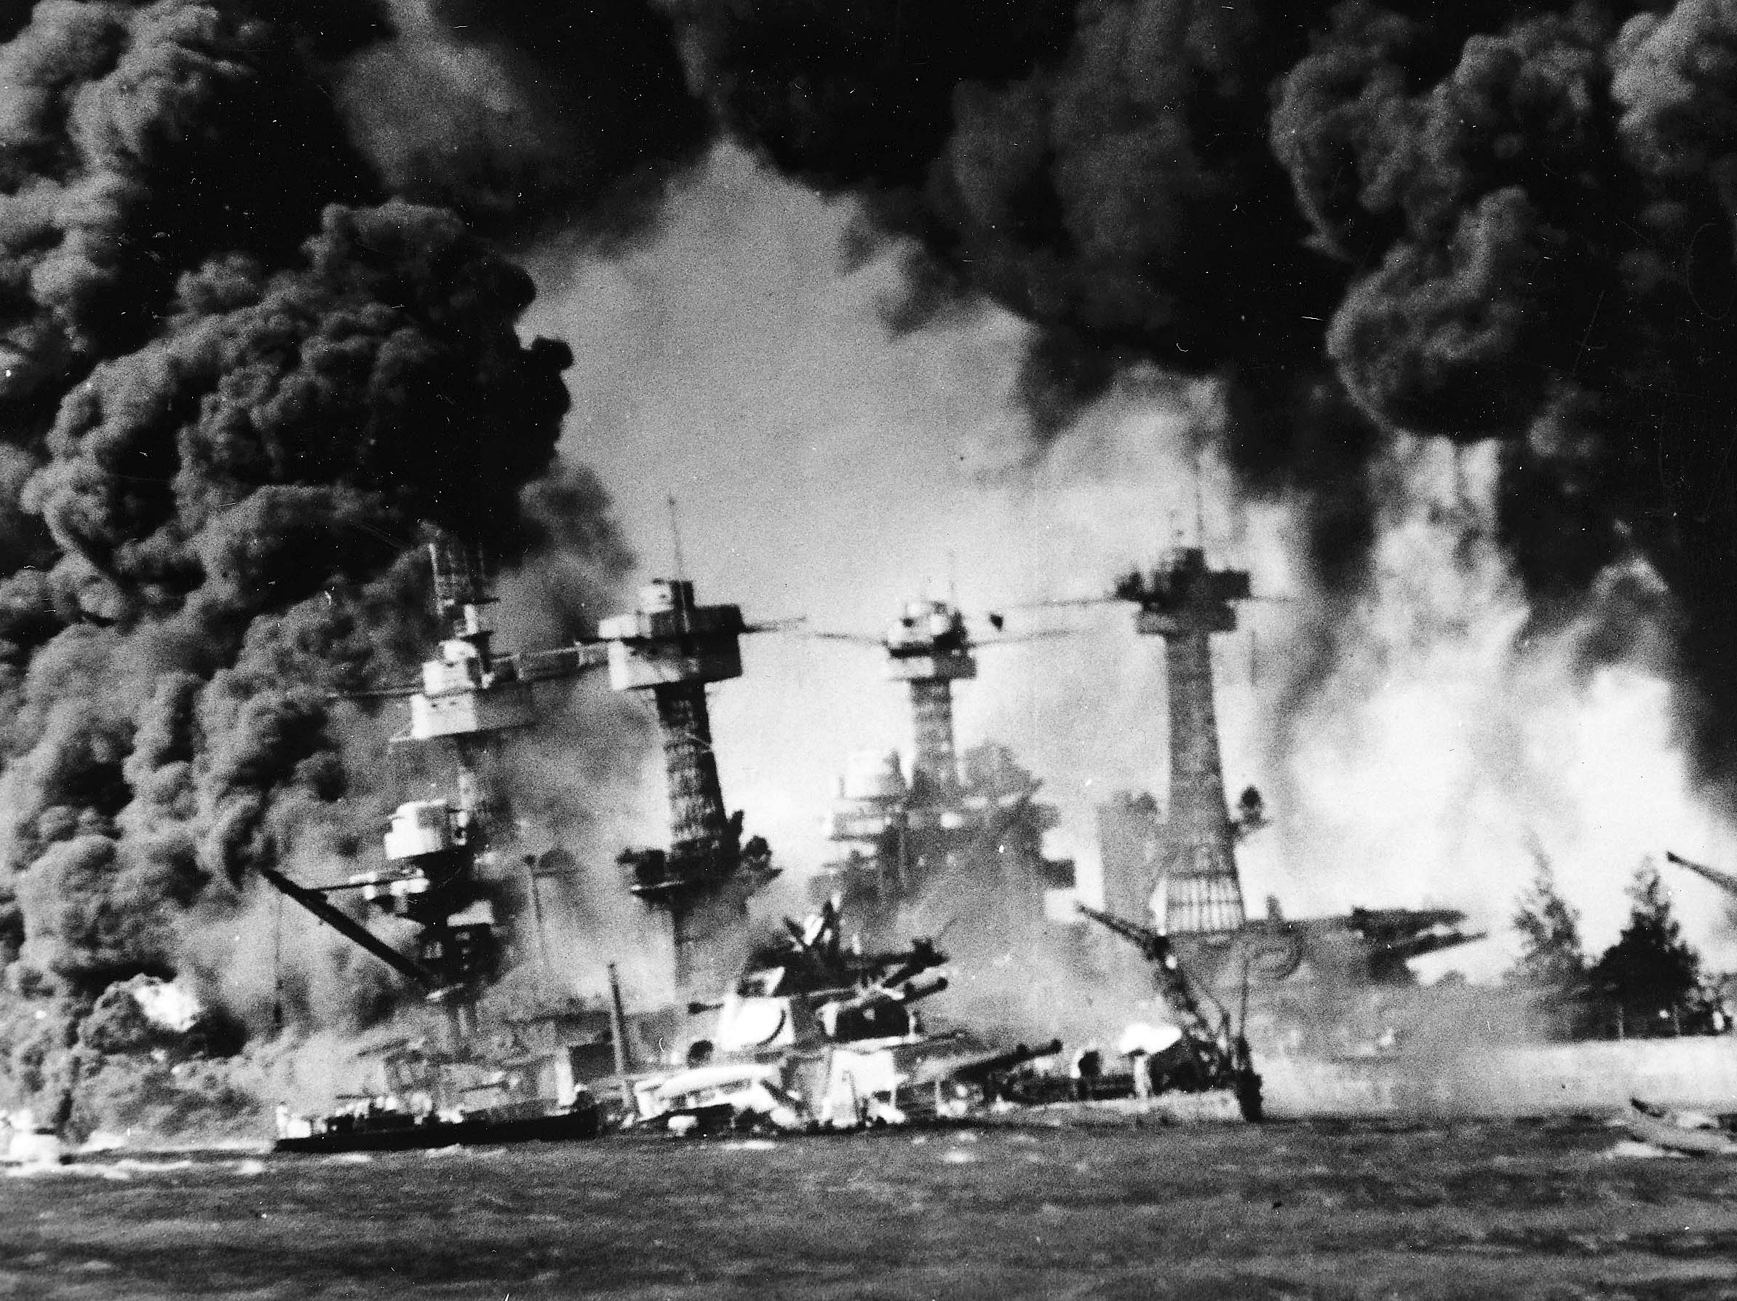
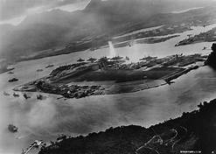
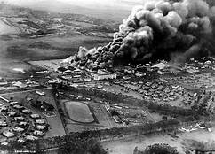

Slide 17
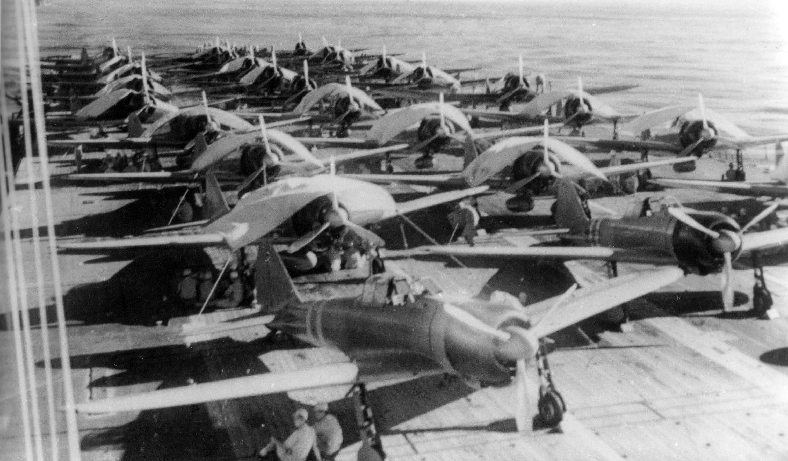
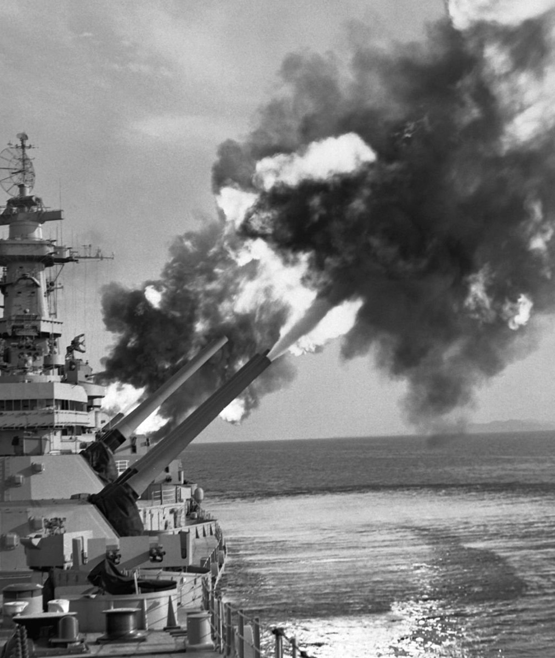
Naval Battle in the Pacific

Slide 18
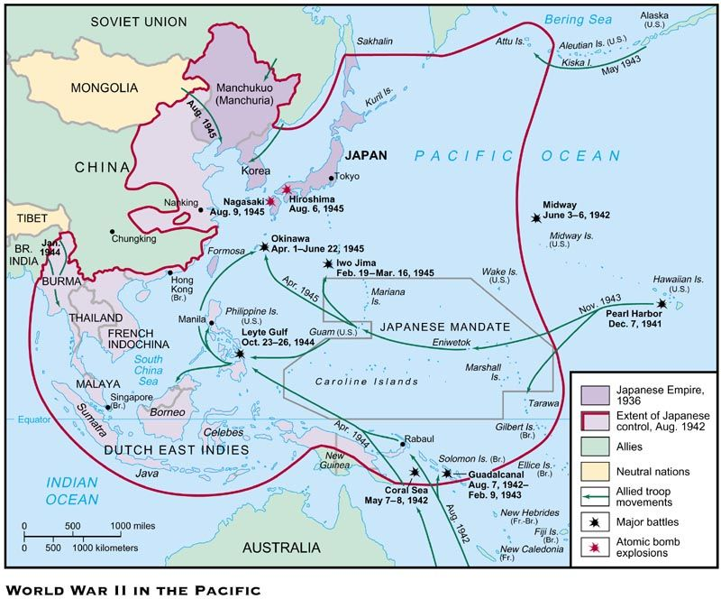

Slide 19
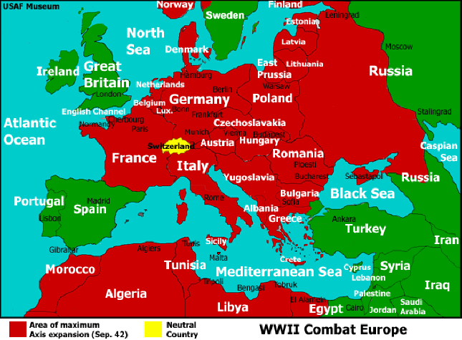
The European Arena

Slide 20
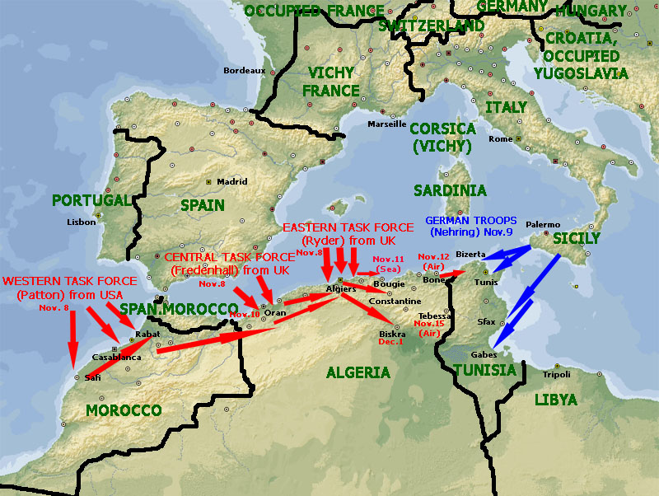
Operation Torch

Slide 21
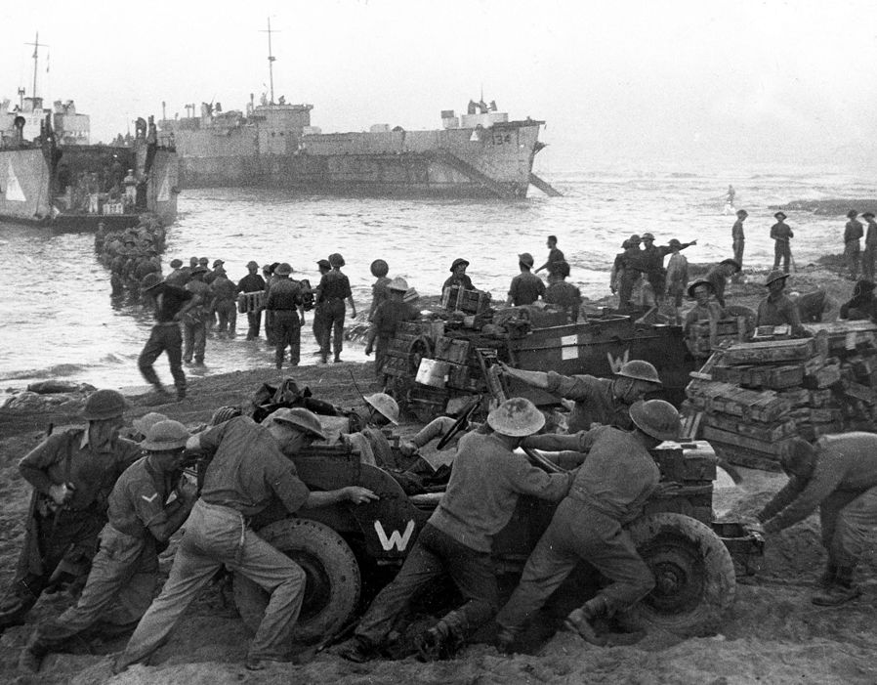
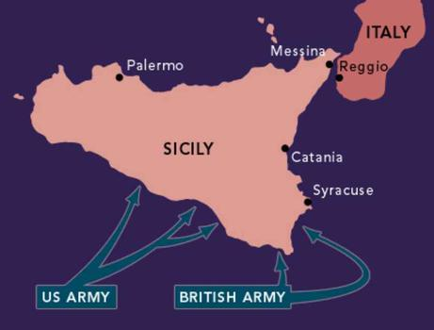
Invasion of Sicily, July 1943

Slide 22
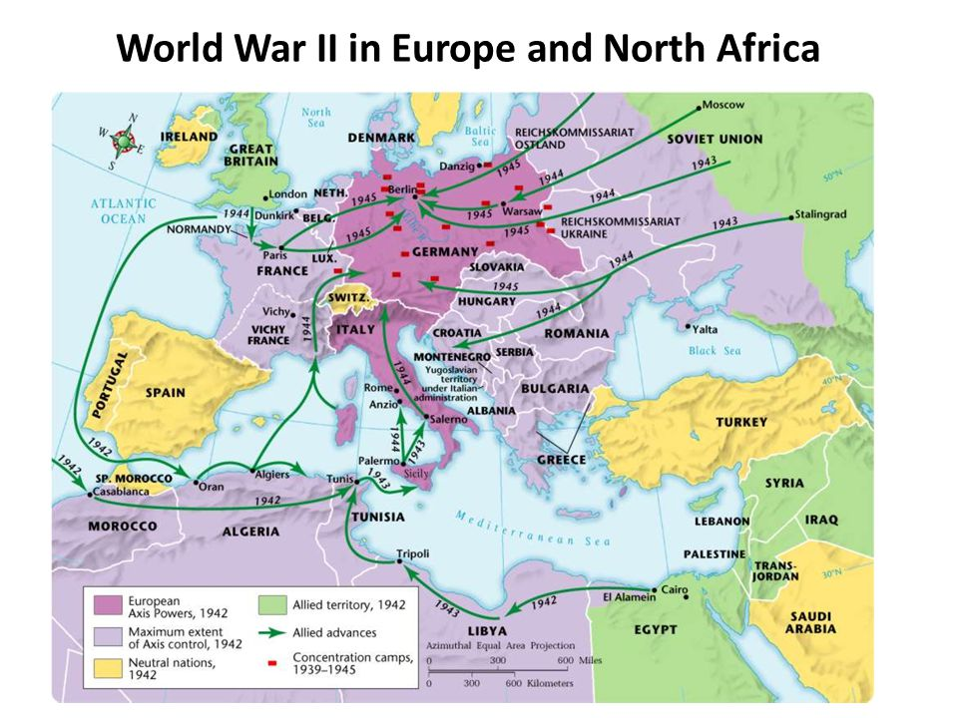

Slide 23
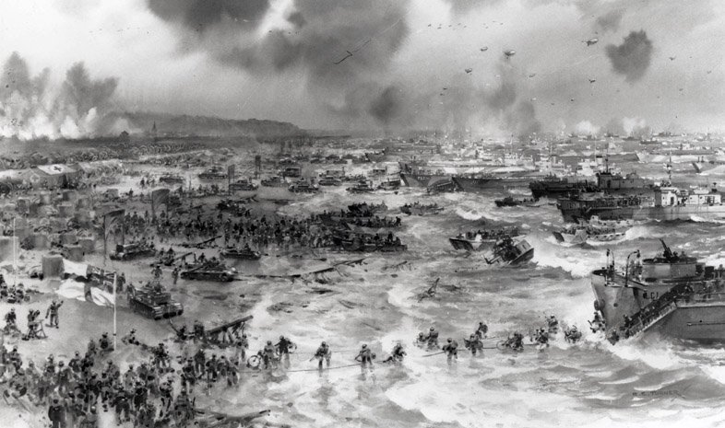
D-Day

Slide 24
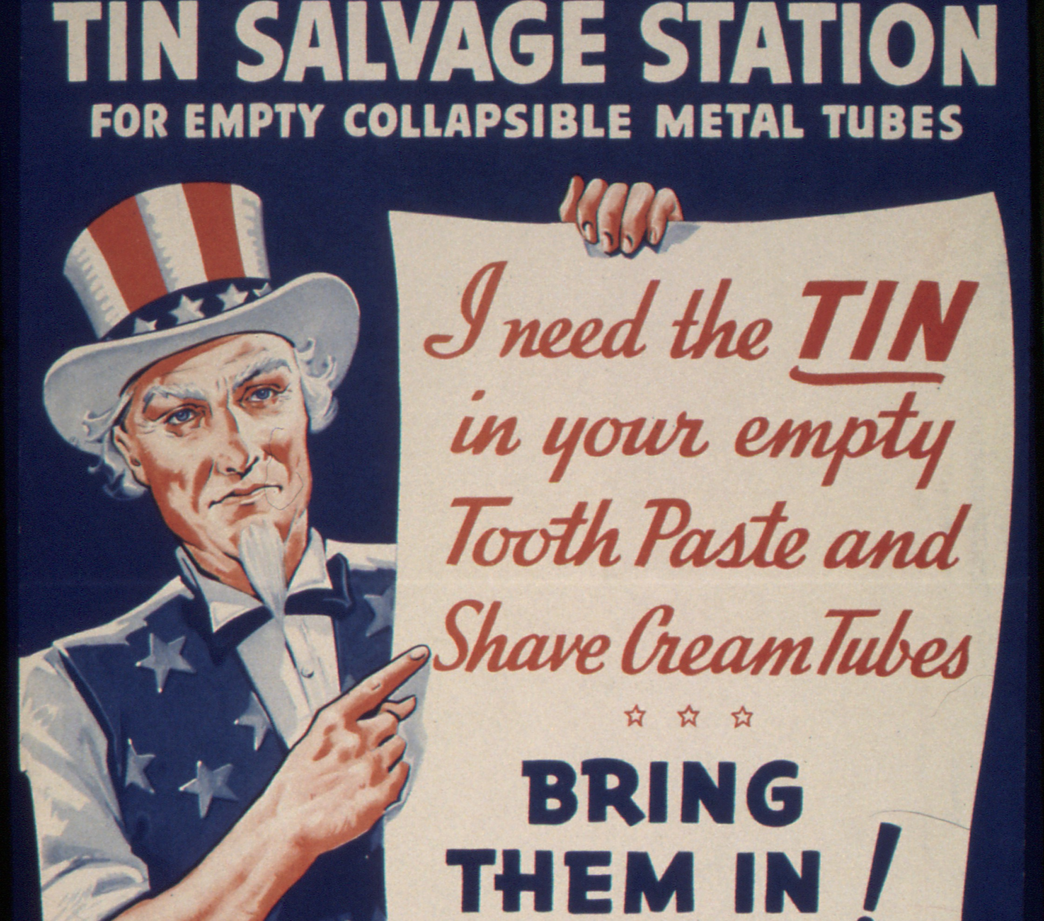

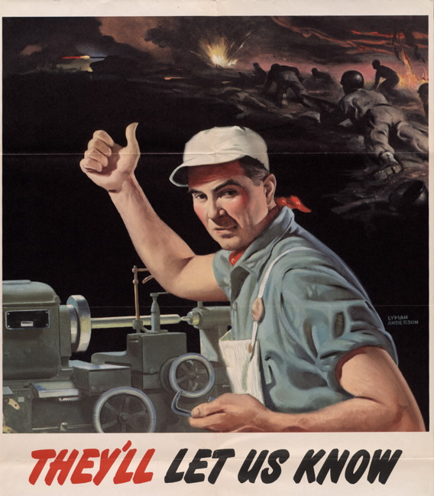
Further Expansion of State Capacities
War Production Board
War Manpower Commission
Office of Price Administration
No Strike Pledge

Slide 25
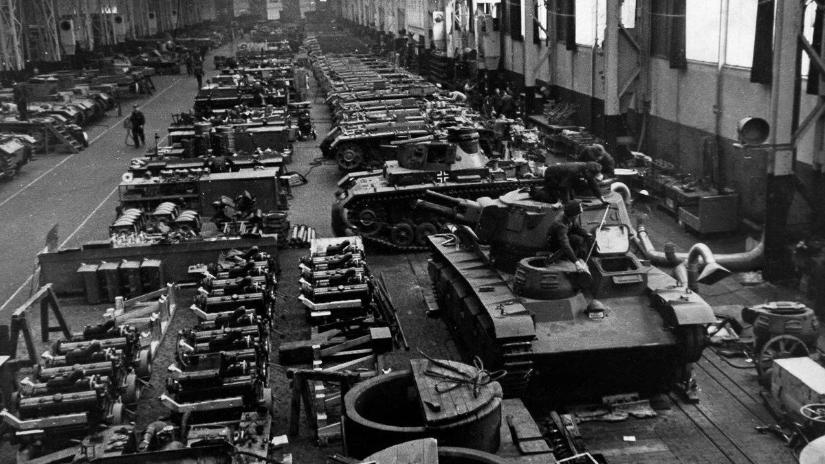
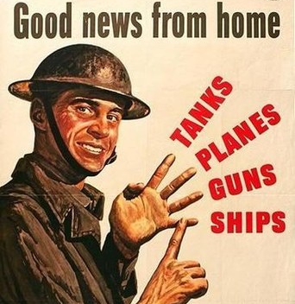
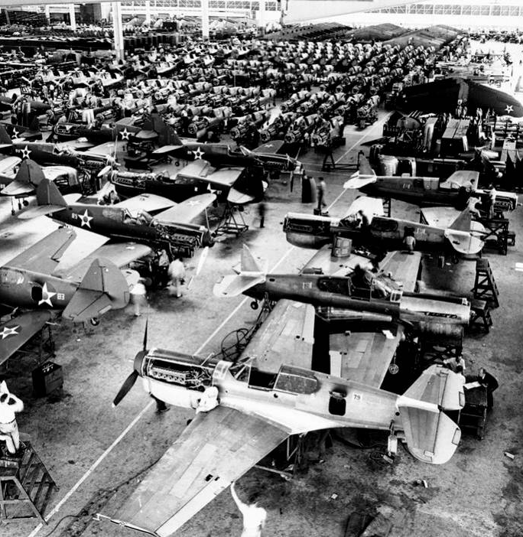
Arsenal of Democracy
Private Companies Turned to Wartime Production, for Profit
By 1944, US produced a plane every five minutes
Ford Motor Company (one company) produced more military equipment than the entire Axis combined
Finally put an end to Depression, with a 235% increase in GDP. What would later be called “military Keynesianism”

Slide 26
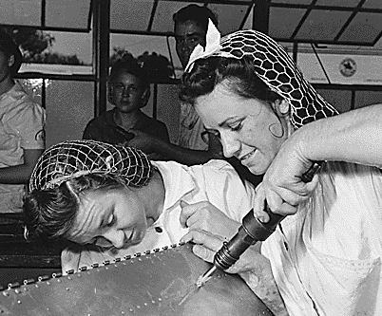
Women join the workforce

Slide 27

Combined Effect
Greatest government control of the economy in U.S. history, full stop
Government purchase of military equipment (for profit) finally ended GD
Increase in sovereign debt
Labor/Democratic Party alliance that persists to the present

Slide 28

Japanese Internment

Slide 29


Slide 30


